Slide 1

Summer Internship
Name:KAUSHAL PARMAR
Roll no: 21BCE179

Slide 2
Internship Details
Company Name: VAP Digital Media Pvt. Ltd.
Position: Trainee Software Developer
Duration: 3rd June - 12th July

Slide 3
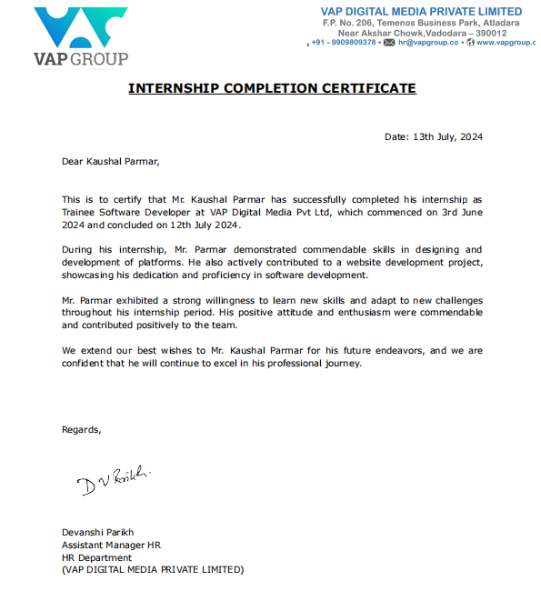
Certificate

Slide 4
Project Overview
Title : GitHub Helper with Laravel
Objective
The primary goal of the GitHub Helper project was to develop a web application that integrates with GitHub to manage and automate repository-related tasks. The application was designed to enhance workflow efficiency by implementing features like branch limit checks and automated notifications.

Slide 5
Technologies and Tools Used
Laravel: Framework for building web applications.
Filament: Admin panel for backend management.
PHP: Server-side scripting language.
XAMPP: Local development environment.
GitHub: Version control.
VS Code: Code editor.

Slide 6
Tasks
Initial Seeder
Scan Widget Validation
Branch Limit Field
Job for Branch Limit Check
Send Email Notification

Slide 7

Initial Seeder
Added demo data to the database for development and testing.
Inserted essential demo records into the database tables.
DB::table('users')->insert([
'name' => 'Demo',
'email' => 'demo@example.com',
'password' => Hash::make('password'),
]);
Outcome: Created initial user with demo credentials to facilitate development and testing.

Slide 8

Scan Widget Validation
Ensured that all required fields (username and token) are provided before processing the scan.
$validator = Validator::make([
'username' => $this->username,
'token' => $this->token,
], [
'username' => 'required',
'token' => 'required',
]);

Slide 9
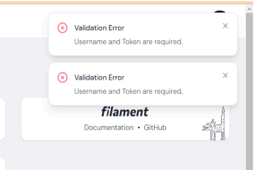
Added validation rules to display error messages when fields are missing. Implemented notifications to alert users of validation errors.

Slide 10
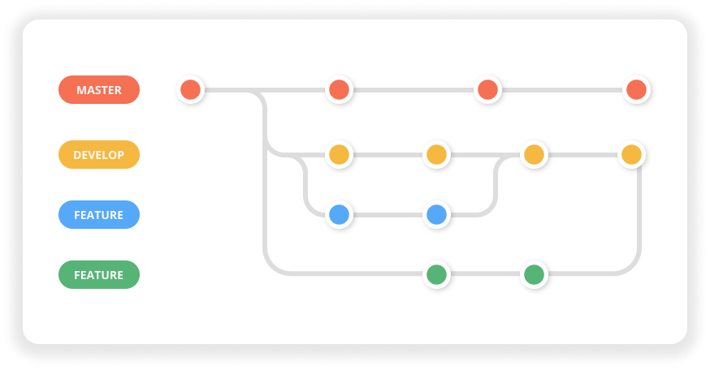
Branch Limit Field
Managed and enforced branch limits for repositories.
Schema::table('github_repos', function (Blueprint $table) {
$table->integer('branch_limit')->default(5);
});
Added branch_limit field to the github_repos table to track branch limits.

Slide 11
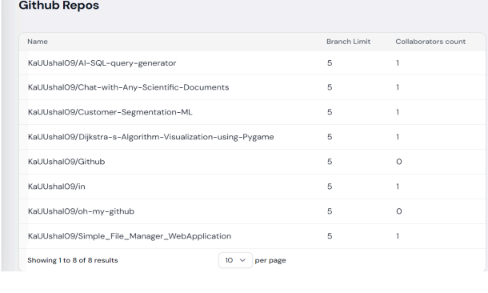
Added a branch_limit field to the repository model. Adjusted migration and seeder files to support this functionality.

Slide 12
Job for Branch Limit Check
To ensure that the number of branches in a repository does not exceed the defined limit.
Created a job to check the branch count against the set limit.
$branchCount = $this->repo->branches()- >count();
if ($branchCount > $this->repo->branch_limit) {
\Log::info('Branch Limit Not Exceeded.');
}

Slide 13

Send Email Notification
Used Laravel’s Mail functionality to send email notifications
To notify users when a repository’s branch limit is exceeded.
Improved user awareness and prompt action on repository management issues.
Enhanced the system’s capability to handle branch limit violations efficiently and effectively.

Slide 14
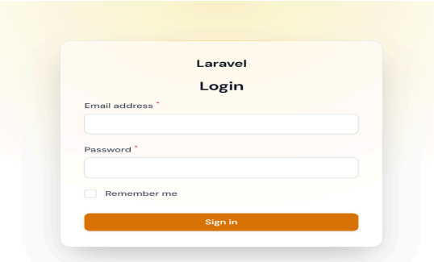
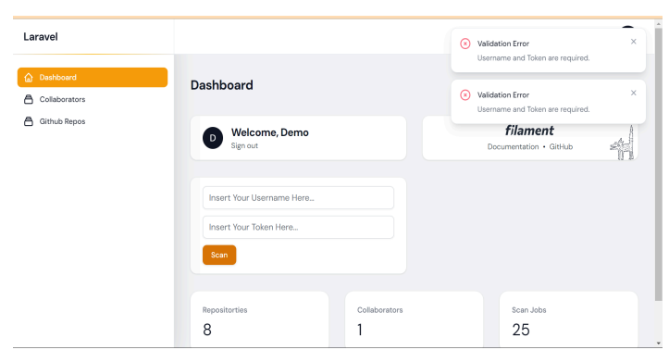
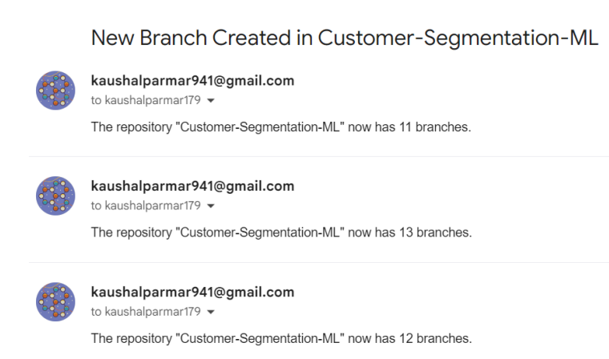
Login Page
Home Page
Repo Details
Email Notification

Slide 15
Skills Gained
Proficiency in Laravel framework and PHP for backend development.
Experience with database management, including creating and modifying migrations and seeders.
Knowledge of implementing validation and automated notifications in web applications.
Enhanced my ability to work collaboratively with a team and manage project tasks effectively.

Slide 16
Conclusion
During my internship at VAP Digital Media, I was immersed in a comprehensive learning environment that greatly enhanced my skills in software development and project management. I gained practical experience with Laravel and PHP, working with these technologies to build and manage web applications. This hands-on involvement not only allowed me to apply theoretical knowledge but also helped me develop a deeper understanding of practical application development.

Slide 17


